Slide 1
Basic Laws of Chemical Combination
Antoine Lavoisier who is one of the founding chemist and Joseph Proust established the two basic laws of matter. These laws explain about the chemical combination of matter.

Slide 2
Law of conservation of mass:
According to this law mass can neither be created nor destroyed in a chemical reaction.
For example
If magnesium ribbon is burned in oxygen or air, the mass of reactants and products will not change.
2Mg ( 48g)+O₂ (32g) = 2MgO(80g)
Mass of Mg 24×2=48g, O₂ = 16×2=32g
It means in a chemical reaction the mass remains same.
Mass of reactants = Mass of products

Slide 3
Law of definite proportions
According to this law Atoms combine in definite ratio thus compound have definite proportion of atoms irrespective of the source of the compound.
For example Water,H₂O has 11.11% Hydrogen no matter what ever is the source of water.
In other words, hydrogen and oxygen has mass in the ratio of 1 : 8 irrespective the source of
water.

Slide 4
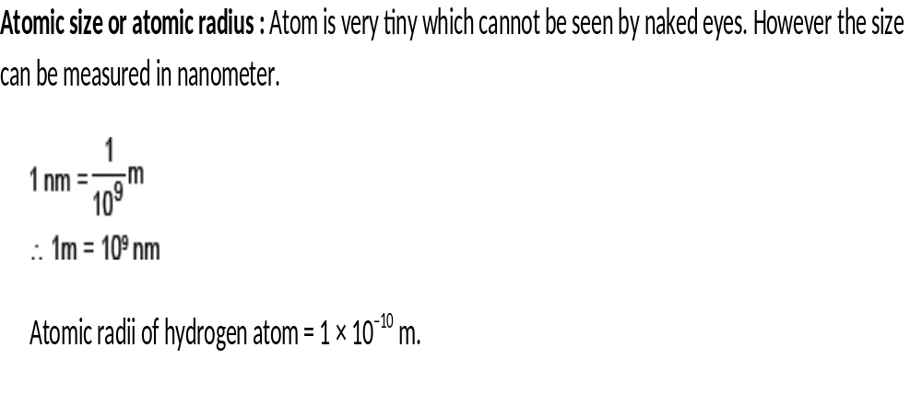
What is an Atom?
An Atom is the smallest particle of an element which can take part in a chemical reaction to form a new substance.

Slide 5
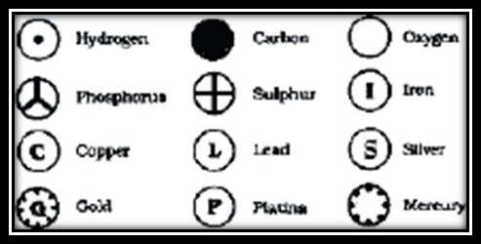
Symbols of Elements
Dalton proposed some symbols for elements.

Slide 6
Modern day symbols of elements
IUPAC((International Union of Pure and Applied Chemistry) approves the names and symbols of elements.
The first letter in capital of the name is generally used as a symbol however many elements also have second letter as well in the name.
The second letter is always small letter.
For example: Berelium is Be and not BE.

Slide 7
Symbols of first 20 elements are as follows.
Element | Symbol of element
Hydrogen | H
Helium | He
Lithium | Li
Berelium | Be
Boron | B
Carbon | C
Nitrogen | N
Oxygen | O
Barium | Ba
Fluorine | F
Neon | Ne
Sodium | Na
Magnesium | Mg
Aluminium | Al
Silicon | Si
Phosphorus | P
Chlorine | Cl
Argon | Ar
Potassium | K
Calcium | Ca

Slide 8
What is a Molecule?
A molecule is the independent unit of a substance.
Types of molecules
Based on elements nature, Molecules are of two types:
Molecule of an element: Such molecule consist only one type of atoms.
For example:
Oxygen gas molecule= O₂
Hydrogen gas molecule= H₂
Ozon gas molecule= O₃
Molecule of compound: Such molecule consists of more than one type of atom.
For example:
Water molecule = H₂O
Carbon di oxide molecule: CO₂

Slide 9
Atomicity of molecule
Based on number of atoms, Molecules are of following types:
Monoatomic molecule: All noble gases are monoatomic molecules because they do not combine with other atoms. They are all stable lements. They have complete outermost shell means octet except helium which has complete duplet( two electron)
Diatomic molecule: Such molecules have two atoms in a molecule. These elements complete their outermost shell by combining between two atoms.
Example: Hydrogen molecule H₂ – Single bond
Oxygen molecule O₂ – Double bond
Nitrogen molecule N₂- Triple bond

Slide 10
Tetratomic molecule: Such molecule has four atoms.
Example: Phosphorus molecule – P₄
Polyatomic molecule: Such molecule contains many atoms.
Example: Sulphur molecule- S_{8.} Sulphur molecule has eight atoms in one molecule

Slide 11
What are ions?
Atoms tend to achieve stable configuration by either loss of electron or gain of electron.
If an atom loses electron, it becomes a positive ion because the number of positive particles (proton) increases and the number of negative particles(electron) decreases.

Slide 12
Metals loose electrons to become positive ions. Positive ions are also called as cations.
Na( 11e and 11 p) – 1e → Na⁺(10 e and 11 p)
Similarly If an atom gains electron, it becomes a negative ion because the number of positive particles(proton) decreases and the number of negative particles(electron) increases.
Cl( 17e and 17 p) +1e → Cl⁻(18 e and 17 p)

Slide 13
What are polyatomic ions?
Polyatomic ions are the ions which are made up of two or more types of atoms.
Example:
Ammonium ion (NH₄)⁺
Sulphite (SO₃ )²⁻
Sulphate (SO₄ )²⁻
Carbonate (CO₃ )²⁻
Hydrogencarbonate (HCO₃ )¹⁻
Nitrate (NO₃ )⁻
Nitrite (NO₂ )⁻
Phosphate (PO₄ )³⁻
Hydroxide OH⁻
Acetate CH₃COO⁻

Slide 14
What is a Valence of an atom?
It is the number of electron lost or gained or shared by an atom in a chemical bond.
In general you can find valence of an atom by looking it in periodic table:
Group | 1 | 2 | 3 | 4 | 5 | 6 | 7 | 8
Valency | 1 | 2 | 3 | 4 | 3 | 2 | 1 | 0

Slide 15
Transition elements
Valency of transition elements is always variable so it is different in different compound.
Example:
Fe has its valency 2 in FeCl₂ and it has valency 3 in FeCl₃

Slide 16
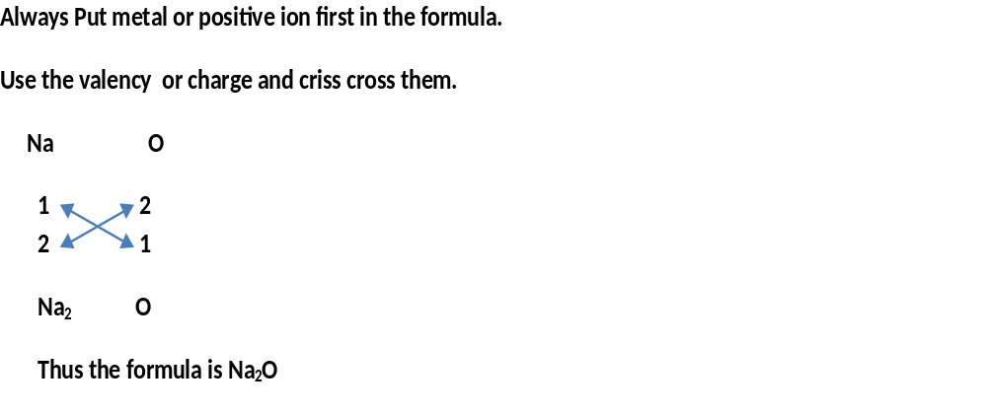
How to write a Chemical Formula from the name of a compound?

Slide 17
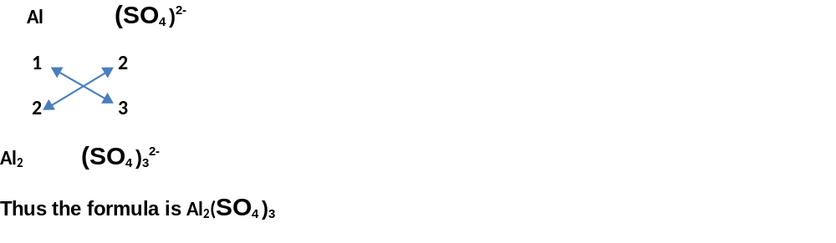
Aluminium Sulphate

Slide 18
What is Relative Atomic Mass(RAM)?
It is the mass of an atom compared with 1/12th part of c-12 isotope.
Since it is relative to carbon or compared with carbon, it is not having any units.
All the periodic table mass are relative atomic mass.

Slide 19
What is relative molecular mass(RMM)?
It is the some of all the relative atomic mass of all the atoms in a molecule.
H₂O = [(H = 1*2=2)+ (0 = 16) = 18]

Slide 20
What is Molar mass?
Mass of one mole of a substance is molar mass. It is always in grams.
The Relative mass if used along with grams, it becomes Molar mass.
For example : RMM of water is 18. If we use gram with it, it will represent 1 mole water and it will be called as molar mass.
1 mole water= 18 g = molar mass. Thus molar mass unit is g/mole.
H₂O = 18]
Similarly CO₂= 44 g= Molar mass.
CO₂= 12+16*2 = 44

Slide 21
What is Formula Unit Mass?
The ionic compounds are not considered as molecules instead as formula units.
The mass of formula unit of an ionic compound is also calculated in the same way by adding all the atomic mass.
For example KCl = 1 × 39 + 1 × 35.5 = 74.5

Slide 22
What is 1Mole?
1 mole is an amount of a substance which contains as many particles as there are in 12 g of C-12 isotopes that is 6.022X10.²³
6.022X10²³ is known as Avogadro’s number. It is important part of mole concept.
Mole= Mass of a substance/Molar Mass
Molar Mass is the mass of 1 mole of a substance in grams.
For example: 1 mole atoms = gram atomic mass = 6.022X10²³ atoms
1 mole oxygen atoms = gram atomic mass of oxygen =16 g = 6.022X10²³ atoms
1 mole molecules = gram molecular mass = 6.022X10²³ molecules

Slide 23
Example –
1 mole oxygen molecules = gram molecular mass of oxygen =32 g =
6.022X10²³ oxygen molecules
1 mole ions = formula unit mass = 6.022X10²³ ions
Example – 1 mole( SO₄)²⁻ ions = formula unit mass of ( SO₄)²⁻=96g = 6.022X10²³
( SO₄)²ions

